Slide 1



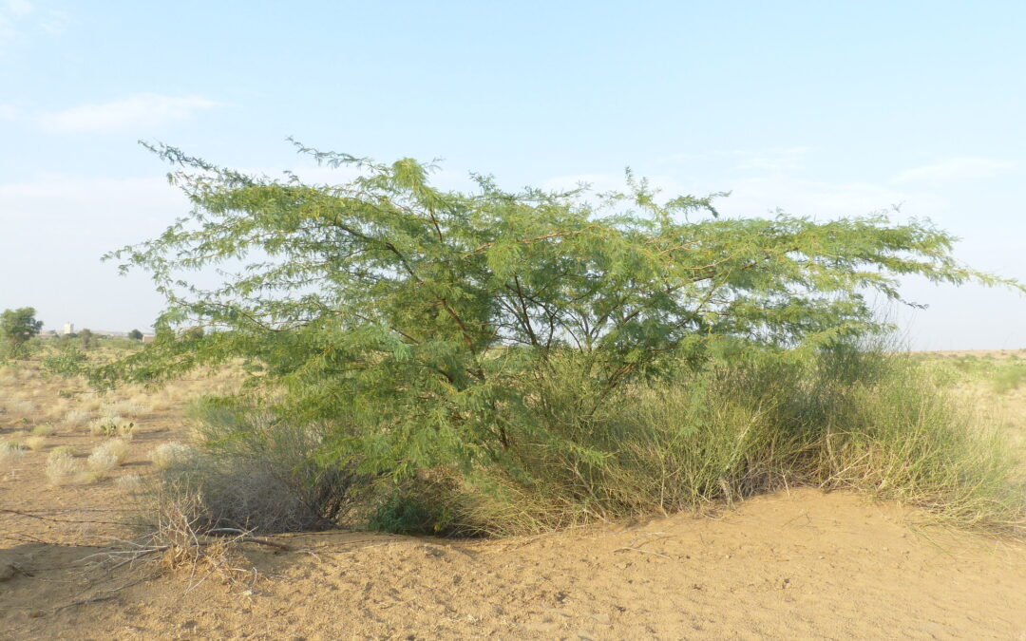
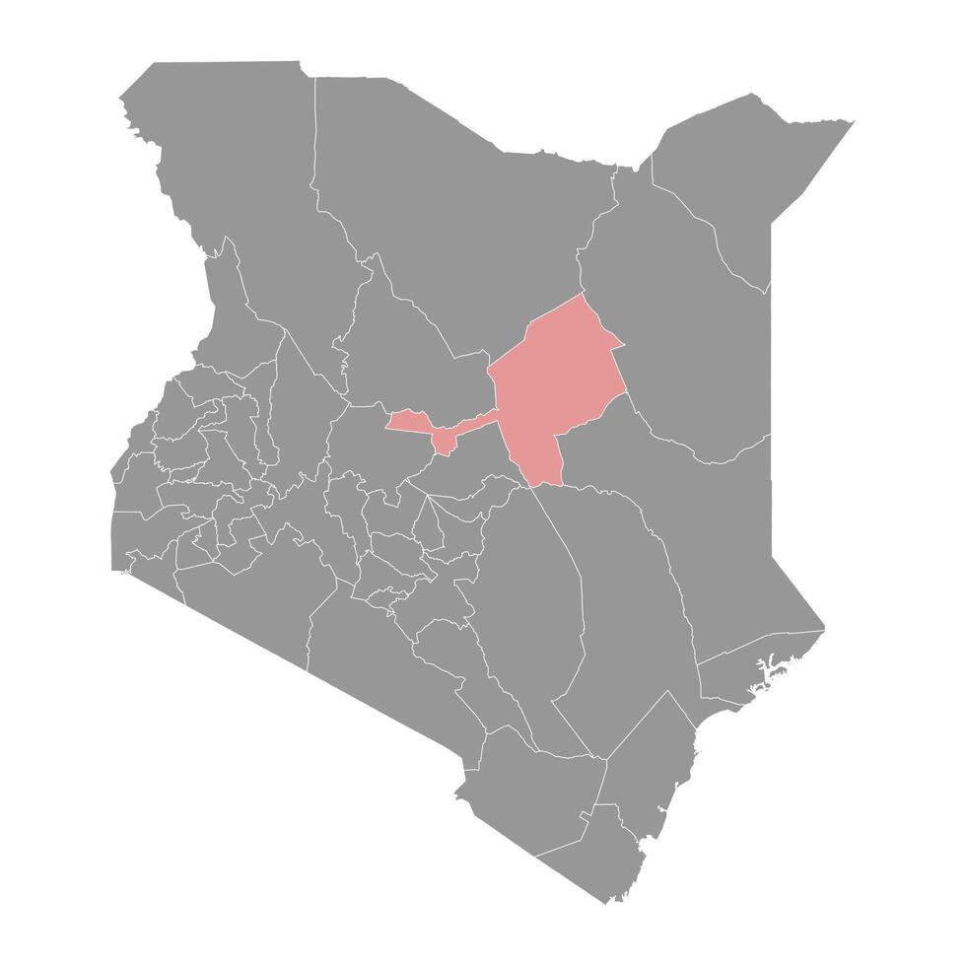
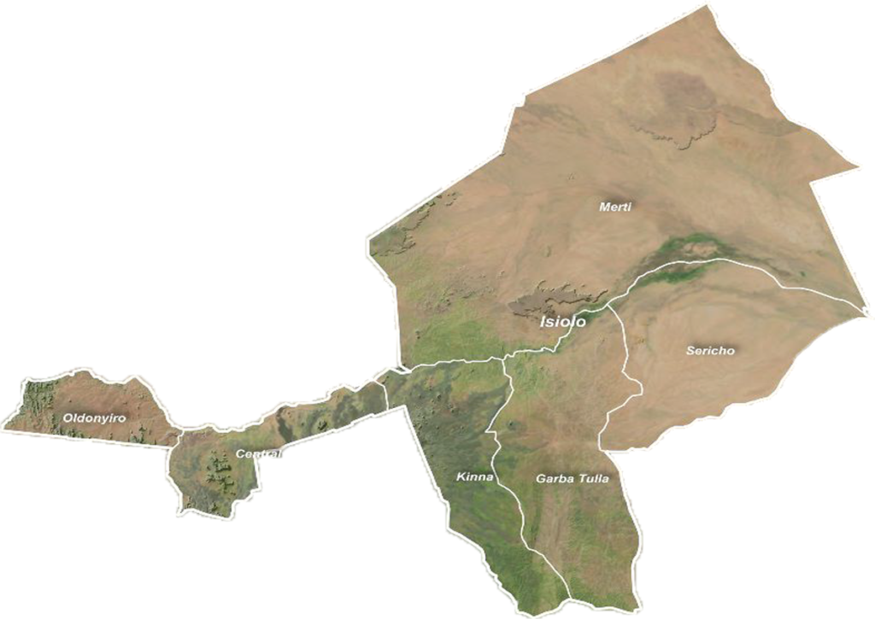



Disease Burden, Prosopis juliflora Association, and Health System Challenges of Visceral Leishmaniasis in Isiolo County, Kenya (2021-2025)
Soransora Diba ¹ Daniel Mwiti ²
1: Department of Health, Isiolo county, Kenya 2:National Public Health Institute, Nairobi, Kenya
BACKGROUND
Visceral leishmaniasis (VL) remains a significant neglected tropical disease in Kenya’s arid and semi-arid regions, with recurrent outbreaks reported in Isiolo County. The interaction between environmental changes, vector ecology, and socio-cultural practices continues to sustain transmission. This study assessed VL burden, epidemiological trends, and key determinants in Isiolo County from 2021 to 2025.
To assess the burden, epidemiological trends, and determinants of visceral leishmaniasis in Isiolo County, Kenya, from 2021 to 2025.
OBJECTIVE
METHODOLOGY
STUDY AREA: Isiolo, Kenya
A mixed-methods retrospective study.
Quantitative data were obtained through health facility record reviews at Isiolo County Teaching and Referral Hospital. Community-level data were collected using structured household surveys (n = 214 households) and complemented by participatory photo voice methods in Merti and Garbatulla sub-counties.
Environmental assessments were undertaken to characterize vector habitats associated with Prosopis juliflora.
Descriptive statistics summarized case frequencies and proportions, while thematic analysis was applied to qualitative data.
STUDY DESIGN
A mixed method retrospective study
RESULTS
DISCUSSION
408 VL cases were reported between 2021 and 2025
case fatality rate of 3.5% (14/408).
Household surveys showed that 63% (135/214) of households reported at least one VL case.
Annual incidence peaked in 2022 (156 cases) and 2023 (146 cases), declined in 2024 (72 cases), and increased again in 2025 (106 cases), coinciding with expansion into Isiolo Sub-County.
Key transmission drivers included Prosopis juliflora invasion, creating favorable sandfly habitats; climatic variability, particularly increased temperatures and erratic rainfall; and nomadic pastoralist practices that increase human–vector contact.
Control efforts were constrained by low community awareness, delayed care-seeking, and limited multi-sectoral coordination
VL transmission in Isiolo County remains persistent and cyclical, with fluctuating trends and recent geographic expansion
High household burden (63%) indicates intense localized transmission in high-risk areas
Prosopis juliflora invasion creates favorable sandfly habitats, sustaining transmission
Climate variability (temperature increase, erratic rainfall) likely drives vector dynamics
Nomadic mobility increases exposure and challenges surveillance and treatment continuity
Health system gaps (low awareness, delayed care-seeking, weak coordination) contribute to ongoing transmission and mortality.
CONCLUSIONS
VL remains a persistent public health threat in Isiolo County, driven by ecological, climatic, and socio-cultural factors, alongside health system constraints.
Integrated control strategies should prioritize targeted vector management in Prosopis-dominated habitats, strengthen climate-sensitive surveillance, expand mobile health services for nomadic populations, and enhance culturally appropriate community engagement and risk communication.
Isiolo county Goverment , Amref health africa , CDC, AFENET and National MOH
ACKNOWLEGEMENT :
Contact: [Soransoradiba@gmail.com]

